Slide 1
Language Team Overview
EMNLP 2020

Slide 2



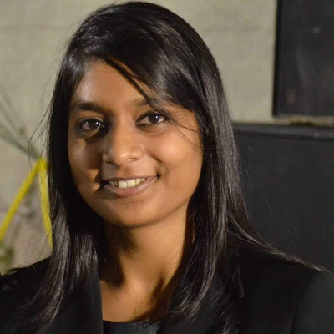






















Language Team
: is at ACL 2020
Adhi Kuncoro
Aida Nematzadeh
Aishwarya Agrawal
Amy Wu
Andrew Trask
Angeliki Lazaridou
Chris Dyer
Cyprien de Masson d'Autume
Dani Yogatama
Devang Agrawal
Gábor Melis
Wojciech Stokowiec
John Hale
Kazuya Kawakami
Kris Cao
Laura Rimell
Lei Yu
Lingpeng Kong
Lisa Anne Hendricks
Laurent Sartran
Phil Blunsom
Sebastian Ruder
Susannah Young
Tomas Kocisky
Wang Ling

Slide 3
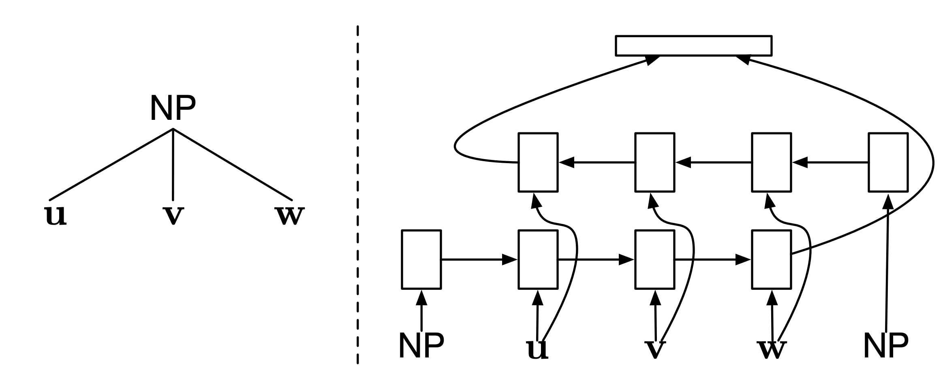
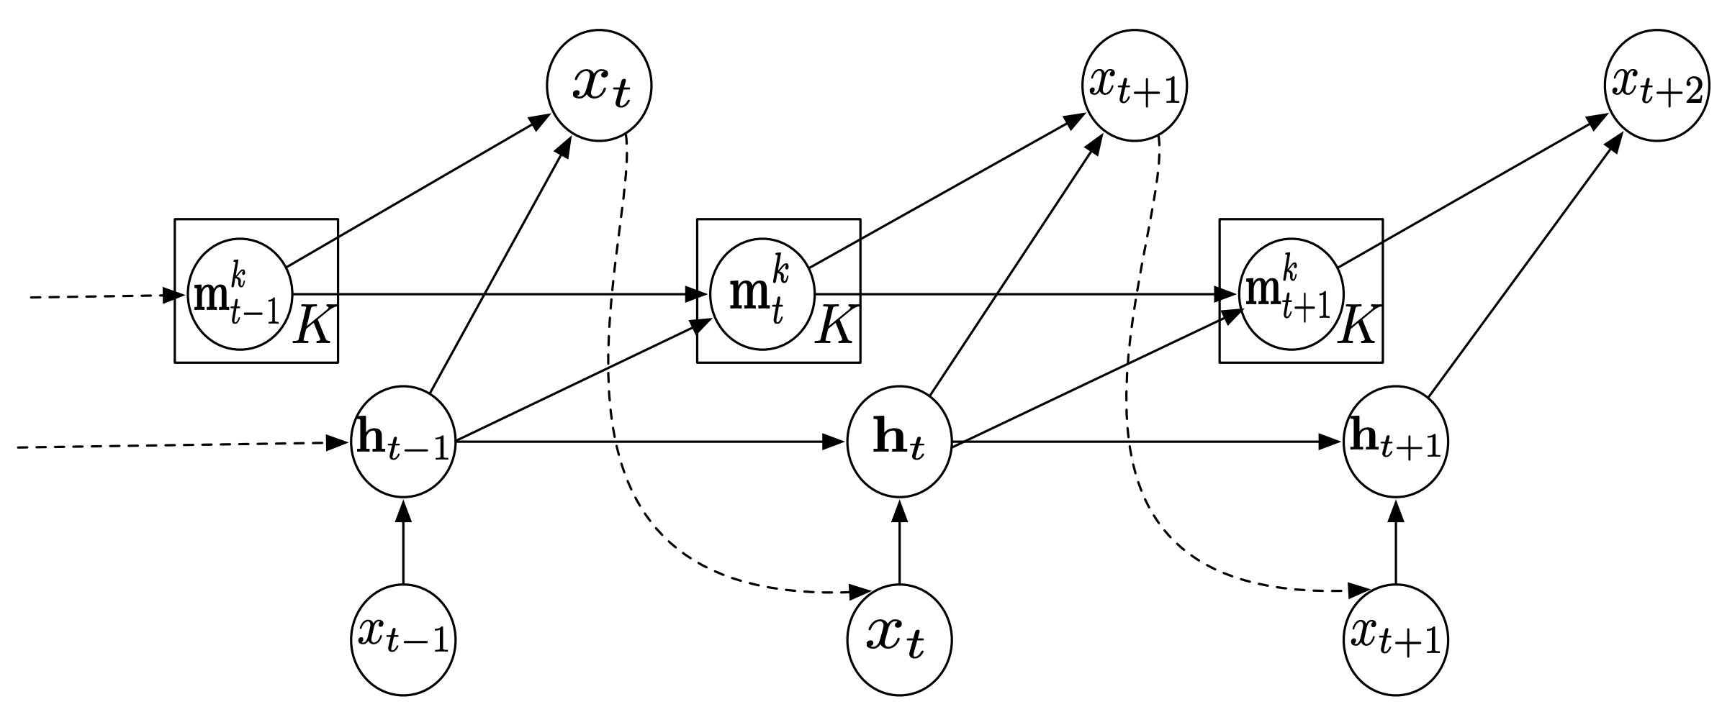

Language Modelling
Language modelling—assigning probabilities to sequences of tokens—is a fundamental NLP task, and better language models have many useful applications. We are interested in the following questions:
What mechanisms allow language models to generalize better?
How can we imbue language models with prior knowledge?
How do we best incorporate longer-range context in our models?
Recurrent Neural Network Grammars (NAACL 2016)
Recent selected publications
On the State of the Art of Evaluation in Neural Language Models (ICLR 2018)
Unsupervised Recurrent Neural Network Grammars (NAACL 2019)
Variational Smoothing in RNN LMs (ICLR 2019)
Mogrifier LSTM (ICLR 2020)
Memory Architectures in RNN LMs (ICLR 2018)
+ previous intern: Yoon Kim
Adhi Kuncoro
Gábor Melis
Lingpeng Kong
Dani Yogatama
Phil Blunsom
Kris Cao
Chris Dyer
Kazuya Kawakami

Slide 4
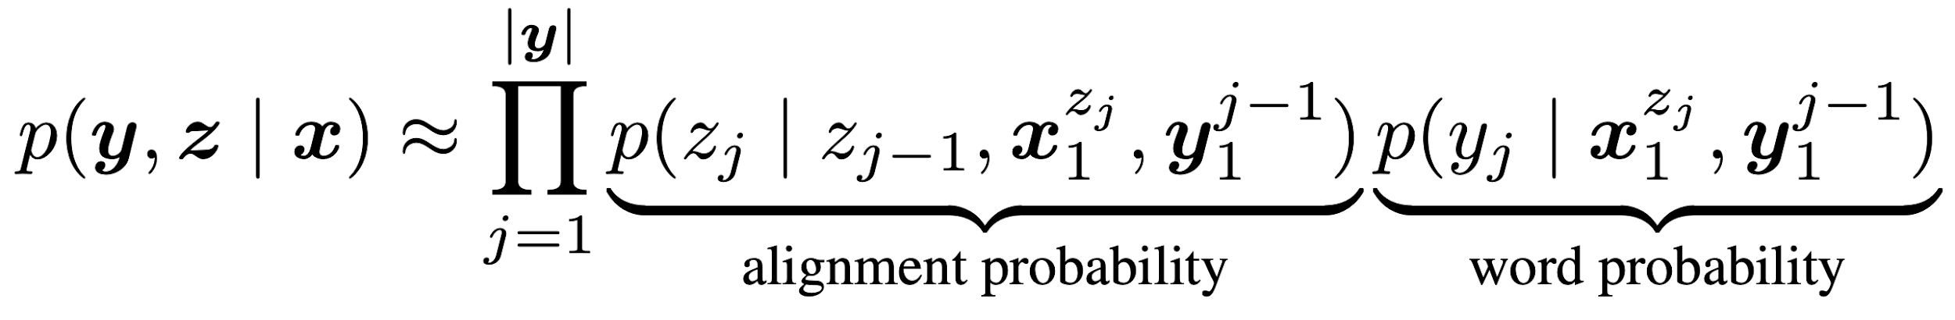
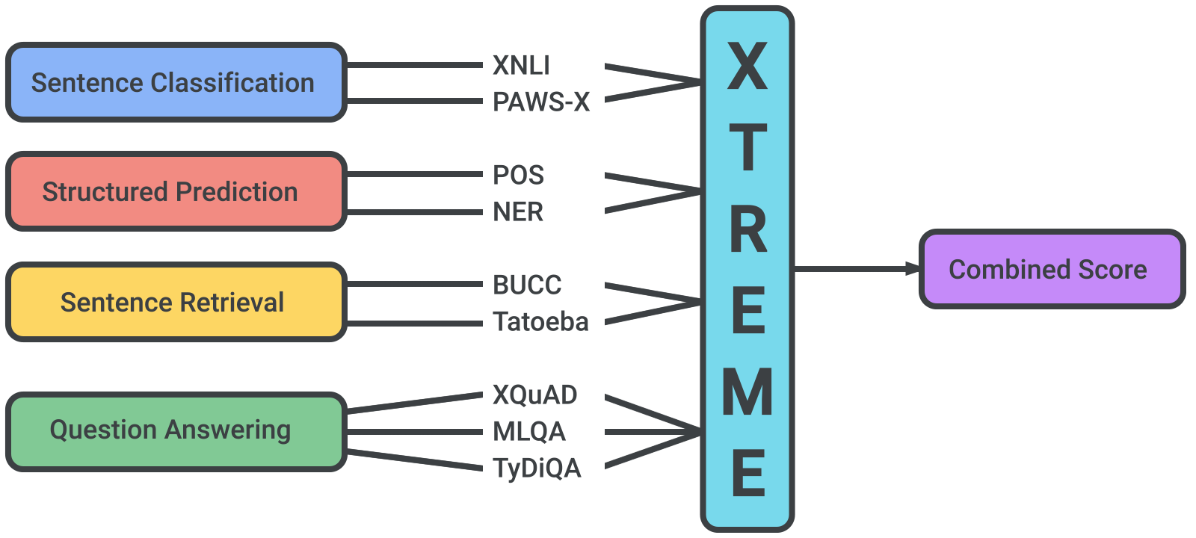
Machine Translation and Multilingual NLP
In order to develop general NLU methods, we need to learn abstractions that can generalise to any language. This will also help overcome language barriers and enable wider access to information. We are interested in the following questions:
How can we incorporate additional context and leverage monolingual data in neural machine translation?
How can we learn representations that generalise to extremely low-resource scenarios?
What structural biases do we need for cross-lingual generalisation?
The Neural Noisy Channel (ICLR 2017)
Recent selected publications
Better Document-level Machine Translation with Bayes’ Rule (TACL 2020)
On the Cross-lingual Transferability of Monolingual Representations (ACL 2020)
Capturing document context inside sentence-level NMT models with self-training (arXiv 2020)
A Call for More Rigor in Unsupervised Cross-lingual Learning (ACL 2020)
XTREME (ICML 2020)
+ previous interns: Mikel Artetxe & Elman Mansimov
Lei Yu
Chris Dyer
Sebastian Ruder
Dani Yogatama
Phil Blunsom
Tomas Kocisky
Laurent Sartran
Wojciech Stokowiec
Papers presented at ACL 2020

Slide 5
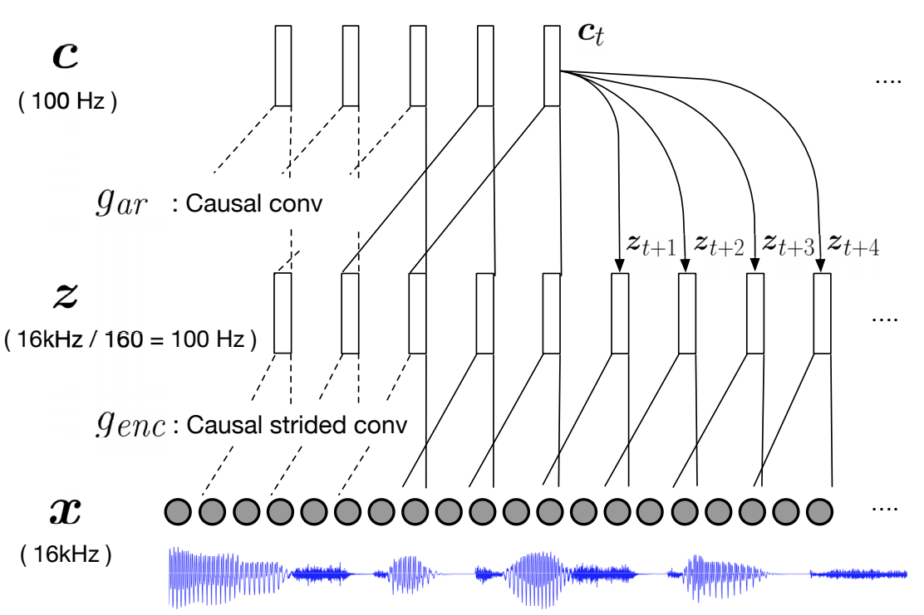
Representation and Transfer Learning
We are interested in learning robust and transferable representations. Our research directions in this area include:
What biases and architectures allow us to deal with the full complexity of natural language across a variety of tasks?
How can we effectively store and reuse representations?
How can we adapt to new tasks in environments with limited amounts of data?
Recent selected publications
Sentence Encoding with Tree-constrained Relation Networks (arXiv 2018)
Learning and Evaluating General Linguistic Intelligence (arXiv 2019)
Episodic Memory in Lifelong Language Learning (NeurIPS 2019)
On Mutual Information Maximization for Representation Learning (ICLR 2020)
Modelling Latent Skills for Multitask Language Generation (arXiv 2020)
Syntactic Structure Distillation Pretraining For Bidirectional Encoders (arXiv 2020)
Learning Robust and Multilingual Speech Representations (arXiv 2020)
Adhi Kuncoro
Dani Yogatama
Lingpeng Kong
Sebastian Ruder
Kazuya Kawakami
Lei Yu
Kris Cao
Cyprien de Masson d'Autume

Slide 6
Document Modelling and Question Answering
We want to go from understanding sentences to documents and beyond. We are interested in the following questions:
What is the best way to test document understanding and how to construct such test sets?
How can we understand and integrate information across a long text or multiple documents?
How can we reason about events, entities, and their relationships over time?
Selected publications
Teaching Machines to Read and Comprehend (NeurIPS 2015)
Program Induction by Rationale Generation: Learning to Solve and Explain Algebraic Word Problems (ACL 2017)
Reference-Aware Language Models (EMNLP 2017)
The NarrativeQA Reading Comprehension Challenge (TACL 2018)
+ previous intern: Zichao Yang
Tomas Kocisky
Wang Ling
Dani Yogatama
Phil Blunsom
Chris Dyer
Gábor Melis

Slide 7
Multi-agent Communication and Dialogue
One of the fundamental functions of natural language is that of communication. Some of the questions that we are currently tackling are:
How can we leverage multi-agent and reinforcement learning framework to tackle problems related to communication and dialogue?
What are the properties of communication protocols emerging within multi-agent interactions grounded to a particular task?
Can we nudge these properties to resemble those found in human communication?
Can we use pre-trained and large scale language models as a key component of dialogue systems? What’s the most appropriate way to do so?
Angeliki Lazaridou
Kris
Cao
Laura
Rimell
Recent selected publications
Emergent communication through negotiation (ICLR 2018)
Social Influence as Intrinsic Motivation for Multi-Agent Deep Reinforcement Learning (ICML 2019)
Biases for Emergent Communication in Multi-agent Reinforcement Learning (NeurIPS 2019)
Multi-agent Communication meets Natural Language: Synergies between Functional and Structural Language Learning (ACL 2020)
Papers presented at ACL 2020

Slide 8
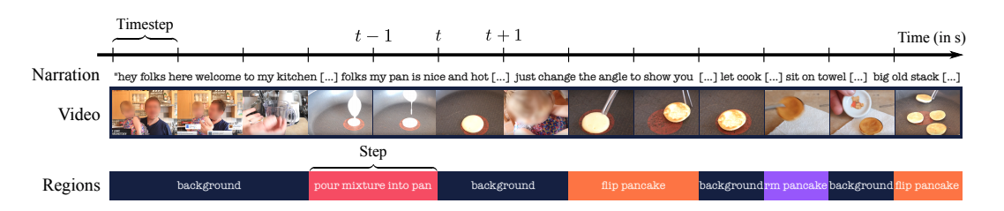
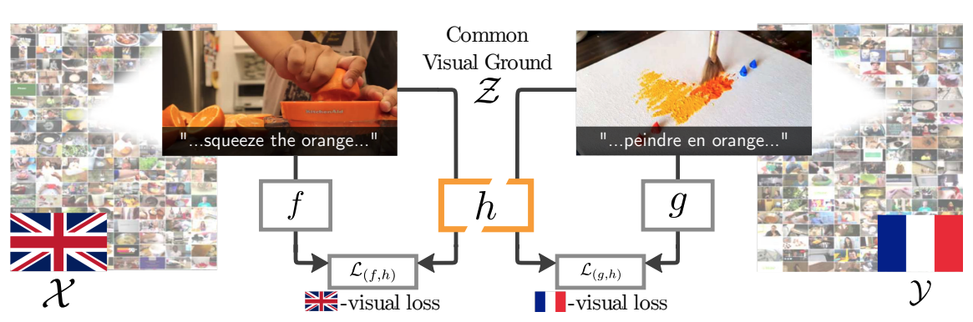
Language + Vision
Lisa Anne Hendricks
In order to communicate about the physical world, AI agents must learn across multiple modalities. We are interested in the following questions:
How can we learn general purpose multimodal features for downstream tasks such as image captioning or visual question answering?
How robust are multimodal features to domain transfer and how can we ensure models do not amplify dataset bias during training?
How can we effectively leverage data from single modality sources (e.g., unlabeled images or uncurated text) for multimodal tasks?
Angeliki Lazaridou
Aishwarya
Agrawal
Aida Nematzadeh
Learning to Segment Actions
Visual Grounding in Video
Recent selected publications
Learning to Segment Actions from Observation and Narration (ACL 2020)
Visual Grounding in Video for Unsupervised Word Translation (CVPR 2020)

Slide 9
Language + Cognitive Science
We take inspiration from cognitive science and linguistics to both better understand child language acquisition and also improve existing NLP systems. Broadly, we aim to:
Shed light on mechanisms involved in human language acquisition by developing computational models and evaluating them against behavioral data.
Identify the shortcoming of existing models by designing evaluation tasks inspired by experiments from developmental psychology.
Improve performance/sample-efficiency of models by integrating them with inductive biases inspired by human cognition.
Recent selected publications
Evaluating Theory of Mind in Question Answering (EMNLP 2018)
Finding syntax in Human Encephalography with Beam Search (ACL 2018 - Best Paper Award)
Text Genre and Training Data Size in Human-like Parsing (EMNLP 2019)
On Memory in Human and Artificial Language Processing Systems (The BAICS workshop at ICLR 2020)
Adhi Kuncoro
Aida Nematzadeh
Angeliki Lazaridou
Chris Dyer
Dani Yogatama
John Hale
Laura Rimell
Sebastian Ruder

